Slide 1
Resurrection Beliefs

Slide 2
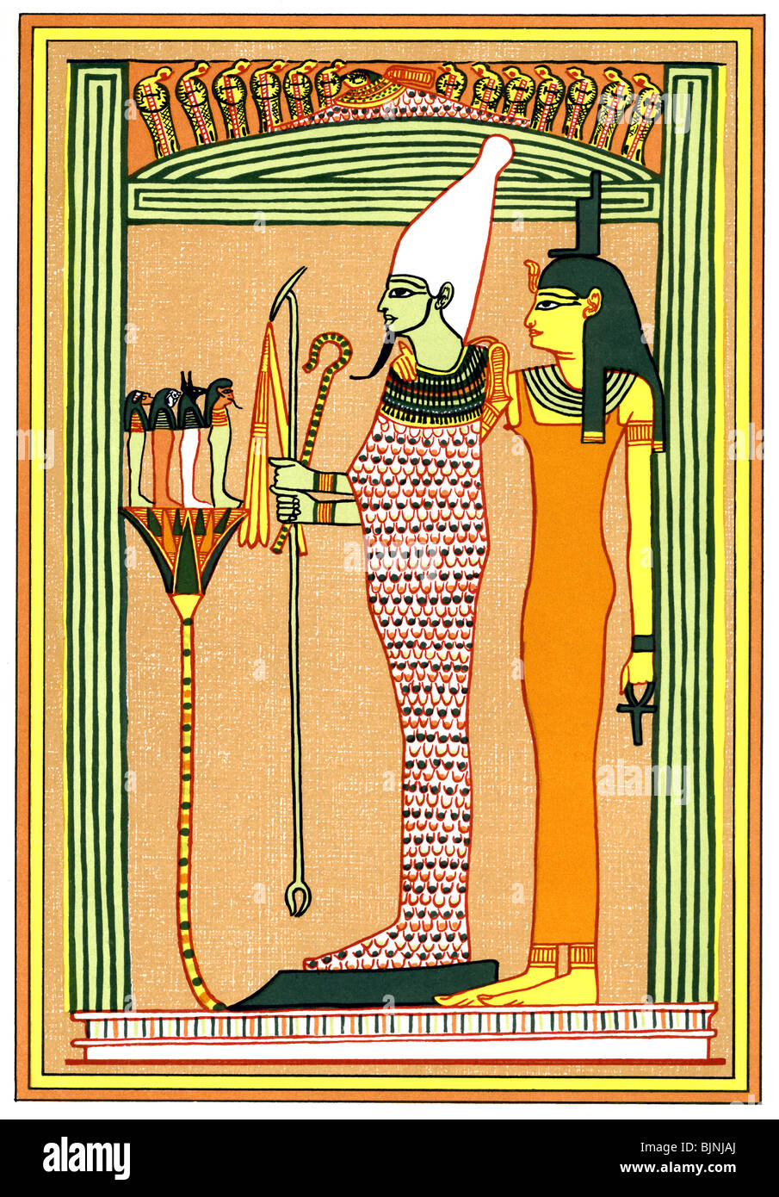
🏺 1. Ancient Egyptian Religion
Core idea: Death is a transition; resurrection is possible through divine power and ritual.
Osiris Myth: Osiris is killed, dismembered, and resurrected by Isis. He becomes ruler of the afterlife.
Pharaohs: Believed to be resurrected after death to join the gods.
Mummification: Designed to preserve the body so the soul (ka and ba) could return and be reanimated.
Type of resurrection: Bodily restoration + eternal life in the afterworld.

Slide 3
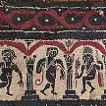
🏛 2. Ancient Greek Beliefs
Greek religion didn’t emphasize resurrection for ordinary people, but myths include it.
Asclepius: A healer who could raise the dead (e.g., Hippolytus).
Dionysus: Dismembered and restored to life in Orphic tradition.
Persephone: Returns from the underworld each year, symbolizing cyclical resurrection.
Type of resurrection: Divine restoration or seasonal rebirth.

Slide 4
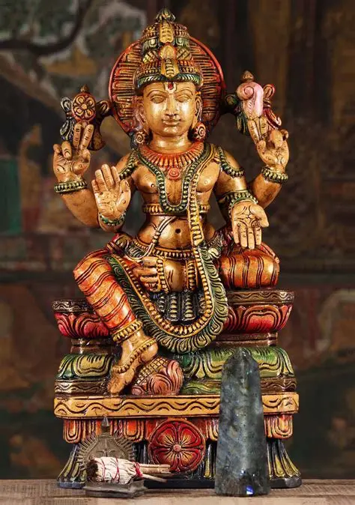
3. Hinduism
Core idea: Life is cyclical; the soul is reborn repeatedly.
Reincarnation (Samsara): The soul takes new bodies across lifetimes.
Avatars of Vishnu: Vishnu “descends” repeatedly in new forms to restore cosmic order.
Type of resurrection: Spiritual rebirth, not bodily return.

Slide 5
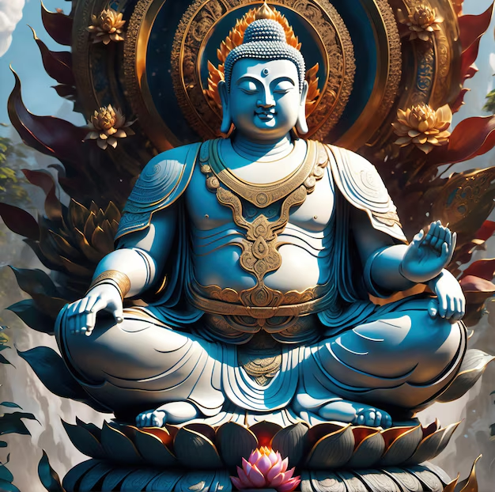
☸️ 4. Buddhism
Buddhism rejects a permanent soul but teaches rebirth.
Rebirth: A stream of consciousness continues into a new life.
Bodhisattvas: Some traditions describe enlightened beings who can choose new births to help others.
Type of resurrection: Continuity of consciousness, not bodily resurrection.

Slide 6
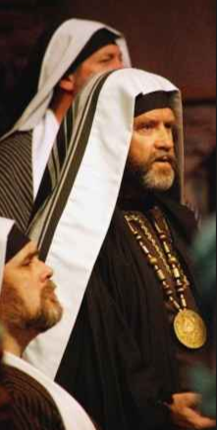
🕎 5. Judaism (Pre‑Christian)
Some Jewish groups before Christianity already believed in resurrection.
Pharisees: Taught bodily resurrection at the end of days.
Book of Daniel (2nd century BCE): Mentions resurrection of the righteous and wicked.
2 Maccabees: Martyrs express hope in bodily resurrection.
Type of resurrection: Future bodily resurrection of the dead.

Slide 7
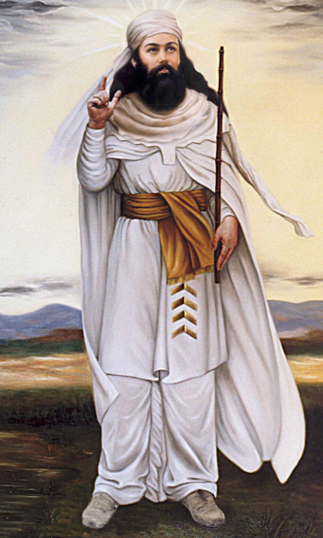
6. Zoroastrianism
One of the earliest religions with a universal resurrection doctrine.
Frashokereti: At the end of time, all humans are resurrected in perfected bodies.
Judgment: Evil is destroyed; the world is renewed.
Type of resurrection: Bodily, universal, and final.

Slide 8
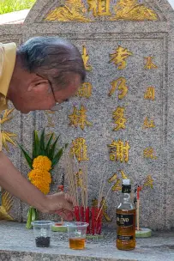
🐉 7. Chinese Traditional Beliefs
Not resurrection in the Western sense, but returning spirits and ancestral continuity.
Hun and Po: Dual souls; one may ascend, one may remain with the body.
Ancestor veneration: The dead remain active in family life.
Type of resurrection: Spiritual return, not bodily.

Slide 9
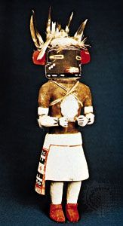
🪶 8. Indigenous Religions (Various)
Many Indigenous cultures have resurrection or return-from-death motifs.
Native American examples:
Hopi: Cyclical worlds; souls may return in new forms.
Cherokee: Some myths describe heroes revived by divine beings.

Slide 10
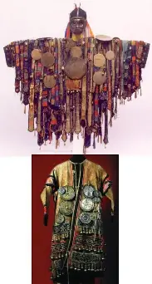

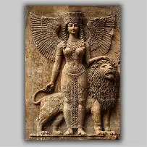
African Traditional Religions:
Yoruba: Ancestors may reincarnate within the family line (atunwa).
Egyptian-influenced Nubian beliefs: Similar resurrection motifs.
Type of resurrection: Reincarnation or spiritual return.
🏹 9. Norse Mythology
Baldr: A god who dies and is prophesied to return after Ragnarök.
Einherjar: Fallen warriors resurrected daily in Valhalla for battle.
Type of resurrection: Divine return + cyclical renewal.
🔥 10. Mesopotamian Religions
Inanna/Ishtar: Descends to the underworld, is killed, and resurrected.
Tammuz/Dumuzi: A dying-and-rising vegetation god tied to seasonal cycles.
Type of resurrection: Seasonal, symbolic, divine.

Slide 11
Summary
Type of Resurrection | Examples | Meaning
Bodily resurrection | Egypt, Zoroastrianism, Judaism | Return to life in the same or perfected body
Reincarnation | Hinduism, Buddhism, Yoruba | Soul takes a new body
Cyclical divine resurrection | Greek, Mesopotamian, Norse | Gods die and return as part of cosmic cycles
Spiritual return | Chinese, Indigenous traditions | Ancestors or spirits remain active

Slide 12
Key Principles in Pre‑Christian Jewish Resurrection Beliefs
Bodily
Collective
End‑time
Justice‑based
Covenant‑rooted
National + individual
Sect differences
Not reincarnation
Divine act

Slide 13
Key Principles in Pre‑Christian Jewish Resurrection Beliefs
1. Resurrection Was Bodily, Not Merely Spiritual
Before Christianity, Jewish thought already held that God would raise the physical body, not just the soul.
The dead would stand again in their bodies
Resurrection was not a ghostly afterlife
The body would be renewed or transformed, but still you
Sources:
Daniel 12:2
Isaiah 26:19
2 Maccabees 7 (martyrs explicitly expect their limbs to be restored)
This is one of the most distinctive features of Jewish resurrection belief.

Slide 14
2. Resurrection Was Collective, Not Individual
Unlike Greek myths where a single hero might return from death, Jewish resurrection was a mass event.
The righteous (and sometimes the wicked) rise together
It happens at the end of history
It is tied to God’s final intervention in the world
This collective nature shaped later Christian and Islamic beliefs.

Slide 15
3. Resurrection Happens at the End of the Age
Pre‑Christian Judaism placed resurrection in a future eschatological moment, not immediately after death.
A final day of judgment
God sets the world right
The dead rise to participate in the renewed creation
This is why Martha in John 11 says, “I know he will rise again in the resurrection at the last day” — she is expressing a standard Jewish belief of her time.

Slide 16
4. Resurrection Was Rooted in God’s Justice
This is the heartbeat of Jewish resurrection theology.
Why resurrection? Because God is just, and justice requires that:
The righteous who suffered must be vindicated
The wicked who prospered must be judged
God must keep His covenant promises, even if death intervenes
This principle becomes especially strong during the Maccabean period, when faithful Jews were being killed for keeping the Law.

Slide 17
5. Resurrection Was Connected to the Covenant
Jewish resurrection wasn’t abstract philosophy — it was covenant theology.
God promised life to His people
Death cannot break God’s covenant
Therefore, God must raise His people to fulfill His promises
This is why resurrection is tied to Israel’s identity, not just personal salvation.

Slide 18
6. Resurrection Was Linked to the Restoration of Israel
In many Jewish texts, resurrection is part of national renewal.
The dry bones vision in Ezekiel 37
The hope of Israel’s return from exile
The expectation of a restored kingdom under God’s rule
Even when the imagery is symbolic, it reflects a belief that God brings life from death — both for individuals and for the nation.

Slide 19
7. Belief Was Not Universal Among All Jewish Groups
Different Jewish sects held different views:
Pharisees: Strongly affirmed bodily resurrection
Sadducees: Denied resurrection entirely
Essenes: Believed in some form of afterlife, possibly spiritual
Common people: Generally aligned with Pharisaic belief
This diversity is important for understanding the New Testament context.

Slide 20
8. Resurrection Was Not Reincarnation
Jewish thought rejected:
Reincarnation
Cyclical rebirth
The idea of the soul migrating to new bodies
Resurrection was once, final, and God‑initiated.

Slide 21
9. Resurrection Was a Divine Act, Not a Natural Process
In Jewish belief:
Humans cannot resurrect themselves
Resurrection is not automatic
It is a miracle of God’s power over death
This contrasts with Greek ideas of the immortal soul or Hindu/Buddhist cycles of rebirth.

Slide 22
Summary
Principle | Meaning
Bodily | The physical body rises again
Collective | A mass resurrection, not isolated cases
End‑time event | Happens at the final judgment
Justice‑based | God vindicates the righteous and judges the wicked
Covenant‑rooted | God keeps His promises to Israel
National + individual | Resurrection tied to Israel’s restoration
Sect‑dependent | Pharisees affirmed; Sadducees denied
Not reincarnation | One-time resurrection, not cycles
Divine act | God alone raises the dead

Slide 23
Accounts of Individuals Raised from Death
 | Person Raised | Raised By | Scripture
 | Widow of Zarephath’s son | Elijah | 1 Kings 17:17–24
 | Shunammite woman’s son | Elisha | 2 Kings 4:18–37
 | Man touching Elisha’s bones | God | 2 Kings 13:20–21
 | Jairus’ daughter | Jesus | Matt 9; Mark 5; Luke 8
 | Widow of Nain’s son | Jesus | Luke 7:11–17
 | Lazarus | Jesus | John 11
 | Many saints | God | Matt 27:52–53
 | Tabitha (Dorcas) | Peter | Acts 9:36–42
 | Eutychus | Paul | Acts 20:7–12
 | Jesus Christ | God | Gospel accounts

Slide 24
Why Christians Believe Jesus’ Resurrection Is Unique in All History
1. Jesus’ Resurrection Was Permanent — He Never Died Again
Every other person raised in the Bible eventually died a second time.
Lazarus died again
Jairus’ daughter died again
The widow’s sons died again
Even those raised in the Old Testament died again
Only Jesus rises to immortal life.
Key text: Romans 6:9 — “Christ being raised from the dead dieth no more.”
This is the single biggest distinction.

Slide 25
2. Jesus Claimed He Would Raise Himself
No one else in Scripture predicts their own resurrection and then accomplishes it.
Jesus says:
“Destroy this temple, and in three days I will raise it up.” (John 2:19)
“I lay down my life… I have power to take it again.” (John 10:18)
Christians see this as divine self‑authentication.

Slide 26
3. Jesus’ Resurrection Was Bodily, Not Symbolic or Spiritual
Christian belief insists:
The tomb was empty
The body was transformed, not discarded
Jesus ate, spoke, walked, and could be touched
This is not a ghost, vision, or reincarnation.
Key text: Luke 24:39 — “A spirit hath not flesh and bones, as ye see me have.”

Slide 27
4. Jesus’ Resurrection Was Publicly Witnessed
Christianity uniquely roots its resurrection claim in historical testimony, not private revelation.
The New Testament lists:
Mary Magdalene
The disciples
Over 500 witnesses at once (1 Corinthians 15:6)
James
Paul
No other ancient resurrection claim has this level of attestation.

Slide 28
5. Jesus’ Resurrection Was Prophesied in Advance
Christians believe Jesus fulfills:
Psalm 16:10 — “Thou wilt not suffer thine Holy One to see corruption.”
Isaiah 53 — The suffering servant “prolongs his days.”
Hosea 6:2 — “After two days will he revive us… the third day.”
Jesus’ resurrection is seen as the climax of the entire biblical story.

Slide 29
6. Jesus’ Resurrection Is Salvific — It Accomplishes Redemption
Other resurrections restore life. Jesus’ resurrection restores creation.
Christians believe:
It defeats death (1 Cor. 15:26)
It justifies believers (Rom. 4:25)
It inaugurates the new creation (2 Cor. 5:17)
It guarantees the future resurrection of all believers (1 Cor. 15:20–23)
No other resurrection claim carries this theological weight.

Slide 30
7. Jesus’ Resurrection Is the Firstfruits of a New Humanity
Christians see Jesus not as one resurrected person among many, but as:
The firstborn from the dead (Col. 1:18)
The firstfruits of them that slept (1 Cor. 15:20)
Meaning: His resurrection is the prototype of the final resurrection of all believers.

Slide 31
8. Jesus’ Resurrection Is Cosmic in Scope
Other resurrections affect individuals. Jesus’ resurrection affects:
Humanity
Creation
Time
History
Eternity
It is the hinge of the Christian worldview.

Slide 32
9. Jesus’ Resurrection Is Central, Not Peripheral
In Christianity:
If Jesus is not raised, the faith collapses (1 Cor. 15:14)
The resurrection is the foundation of Christian hope
The early church preached the resurrection as its core message
No other religion makes its founder’s resurrection the non‑negotiable center of the faith.

Slide 33
Summary of Jesus’s Unique Resurrection
Feature | Jesus | Others in Scripture | Other Religions
Permanent | Yes | No | No
Self‑initiated | Yes | No | No
Bodily + transformed | Yes | Yes (but mortal) | Rarely claimed
Publicly witnessed | Yes | Limited | No
Prophesied | Yes | No | No
Salvific | Yes | No | No
Cosmic significance | Yes | No | No
Central to the faith | Yes | No | No

Slide 34
Conclusion
Christians believe the resurrection of Jesus is unique because it is the only resurrection that is permanent, self‑willed, bodily, historically witnessed, prophetically promised, theologically necessary, and cosmically transformative. It is not simply another miracle — it is the foundation of Christian hope and the defining event of the Christian faith.

